Slide 1

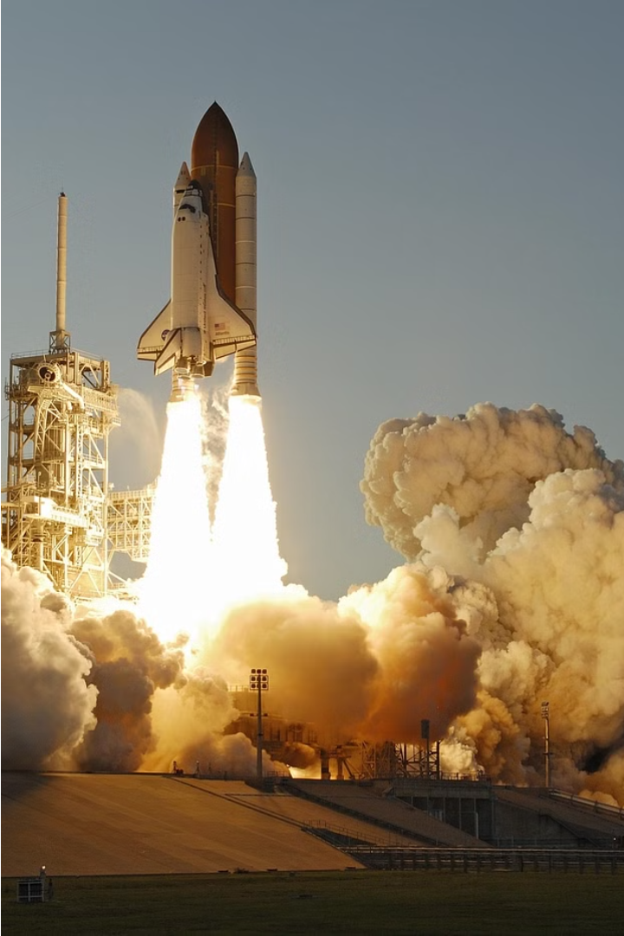

SPACE TOURISM
Explore the wonders of space travel and discover the thrilling opportunities available for space enthusiasts in our comprehensive project on space tourism.
ka
BY: Kritica (2210990523)
Kritika Bansal (2210990524)
Lavika Singla (2210990540)
PRESENTED TO:
Ms. Baljit Kaur
Mr. Vikas Patel

Slide 2
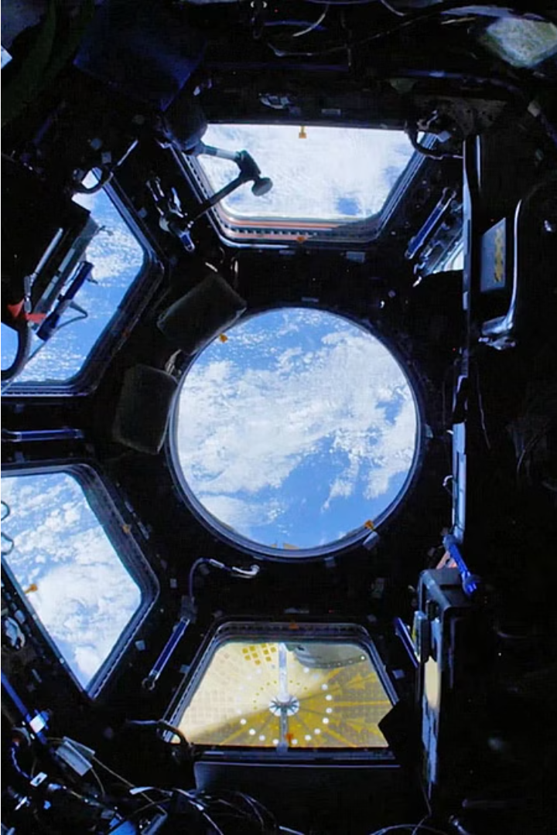
INTRODUCTION:
In our project, we delve into the realm of space tourism, leveraging cutting-edge technology to create an immersive experience for our users. Through stunning visuals and interactive elements, we aim to ignite the curiosity and passion for space exploration within each individual.

Slide 3

OVERVIEW
Create an engaging and immersive experience: We strive to develop a platform that transports users into the realm of space tourism through captivating visuals and interactive features.
Showcase the potential of React.js in web development: By leveraging the power of React.js, we aim to demonstrate its capabilities in building dynamic and user-friendly web applications.
Provide a seamless user experience: Our goal is to ensure that users can navigate the platform effortlessly and enjoy a seamless journey through the wonders of space.

Slide 4
PROJECT GOALS
Engage Users Easily
Showcase Technical Skills
We aim to create a website that's easy for everyone to use, even if they're not familiar with space stuff. We want users to have fun exploring space without feeling overwhelmed.
With React.js, we're crafting a visually stunning and seamlessly functional website. Our aim is to captivate and dazzle our audience while showcasing our expertise in web development.

Slide 5

KEY FEATURES
Responsive Design
Interactive Elements
Tabbed Navigation
View the optimal layout for each of the website's pages depending on their device's screen size.
See hover states for all interactive elements on the page.
View each page and be able to toggle between the tabs to see new information.

Slide 6

INTRODUCTION TO REACT JS
React.js is a JavaScript library for building user interfaces, known for its component-based architecture, virtual DOM, and declarative syntax using JSX.
ADVANTAGES
Performance: React's virtual DOM and efficient reconciliation algorithm make it highly performant.
Reusability: React's component-based architecture promotes code
Community and Ecosystem: React has a large and active community of developers, which means there are plenty of resources, libraries, and tools available to help with development.
SEO-Friendly: React can be rendered on the server side using technologies like Next.js or Gatsby.js.

Slide 7



OTHER TECHNOLOGIES
JSX Markup
Tailwind CSS
Vite
JSX is a syntax extension for JavaScript used with React.js to describe the structure of UI components in a declarative and HTML-like manner, making React code more readable and intuitive.
Tailwind CSS is a utility-first CSS framework that provides a set of pre-defined classes for styling web applications. It promotes rapid development by enabling developers to quickly apply styles.
Vite is a modern build tool for web development that focuses on fast development and optimized production builds. This means you can see changes reflected in your browser almost instantaneously, which is a big productivity booster.

Slide 8

RESPONSIVE
We made our website responsive so that it can adjusts its layout, content, and functionality based on the device and screen size being used to view it. This ensures optimal user experience across various devices, including desktops, laptops, tablets, and smartphones. The goal of responsive design is to provide users with easy access to content and functionality, improving usability and engagement while minimizing the need for horizontal scrolling or zooming.

Slide 9
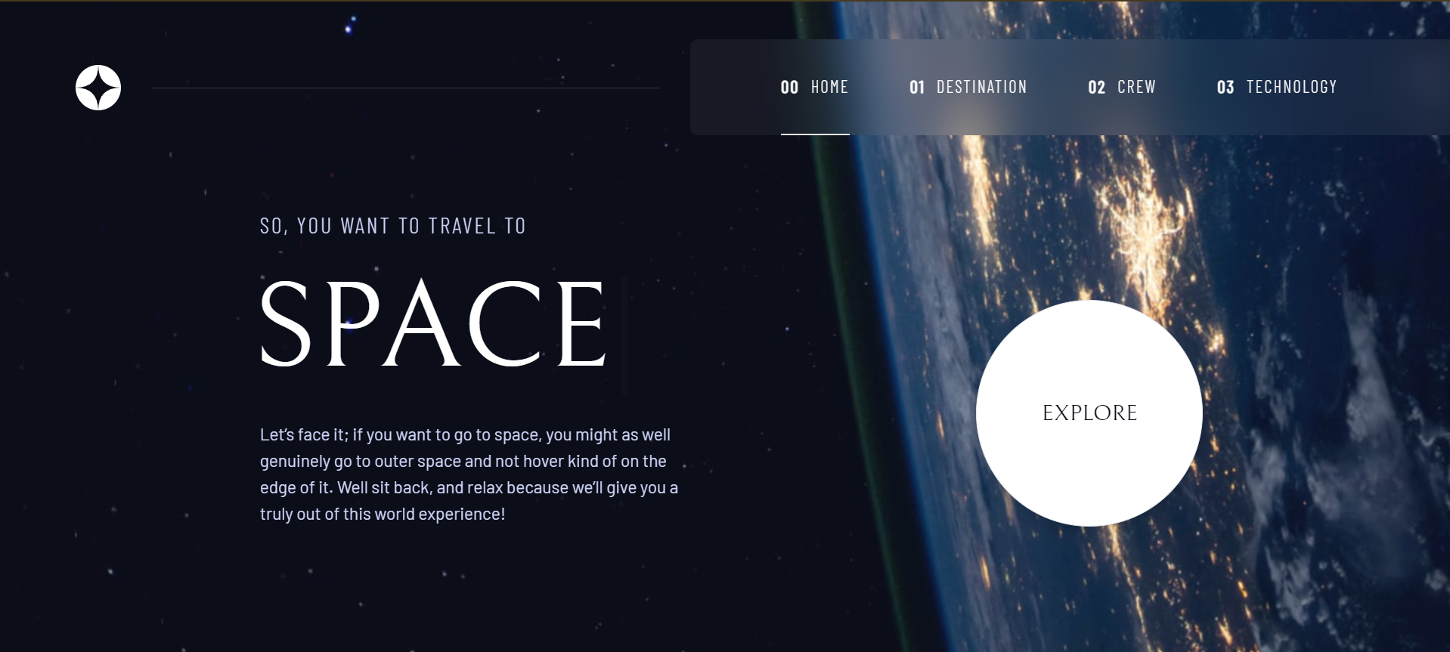
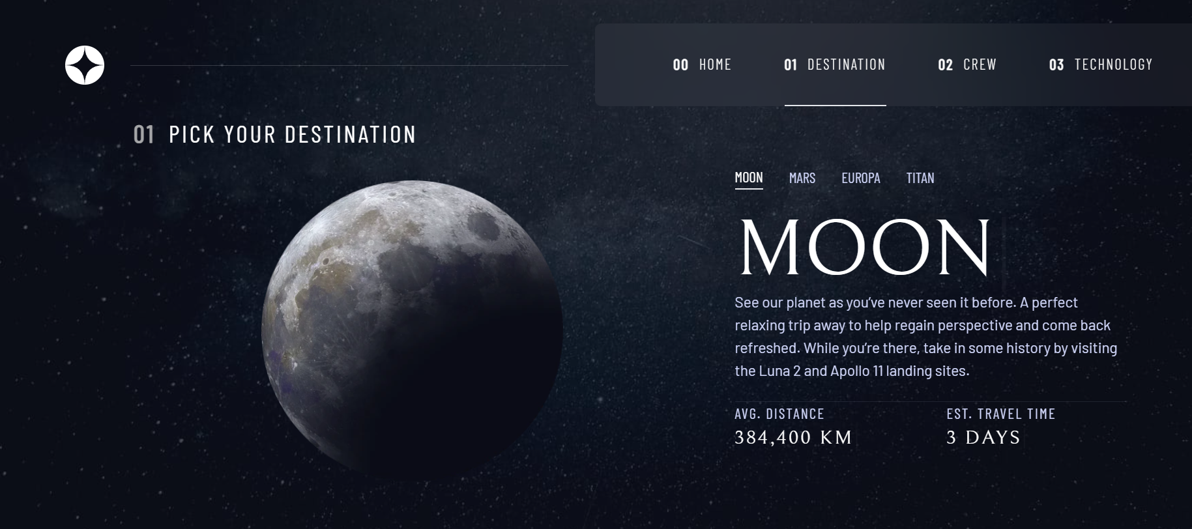
SCREENSHOTS

Slide 10
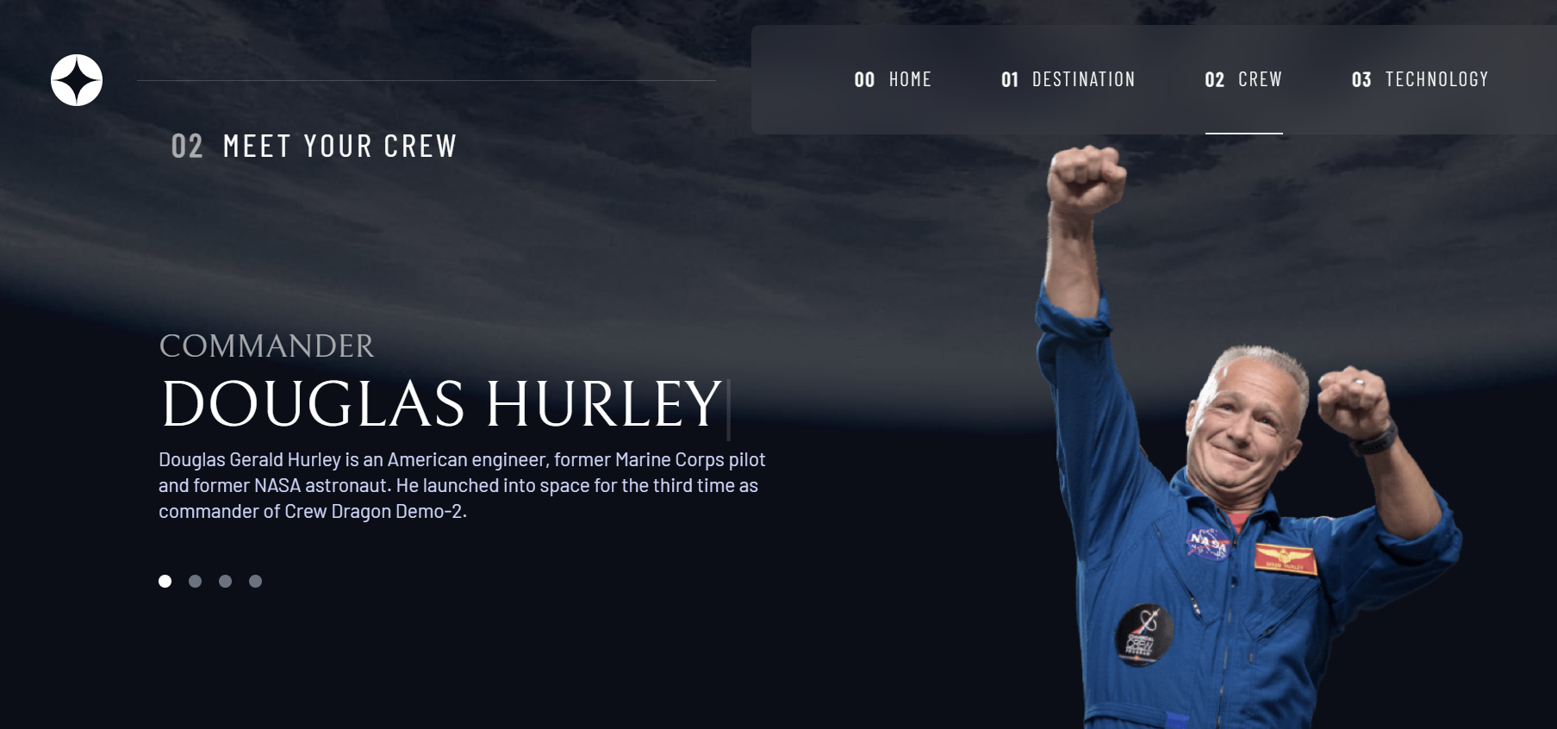
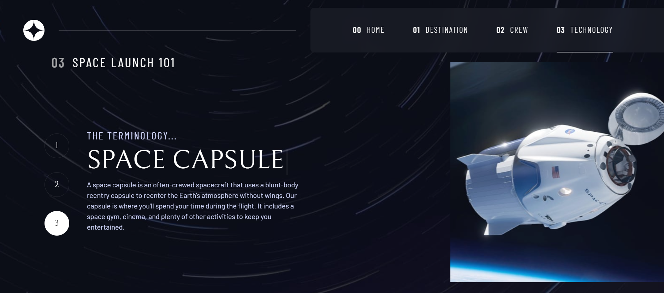
SCREENSHOTS

Slide 11
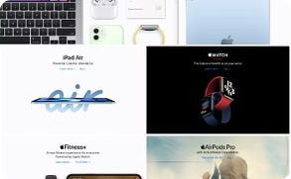


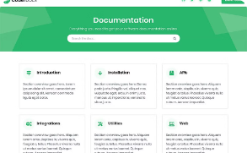
Project Links
Website
GitHub
Live Demo
Documentation
https://space-tourism-xi-eight.vercel.app/
https://github.com/kritkat11/Space-Tourism
demo.spacetourism.com
docs.spacetourism.com

Slide 12
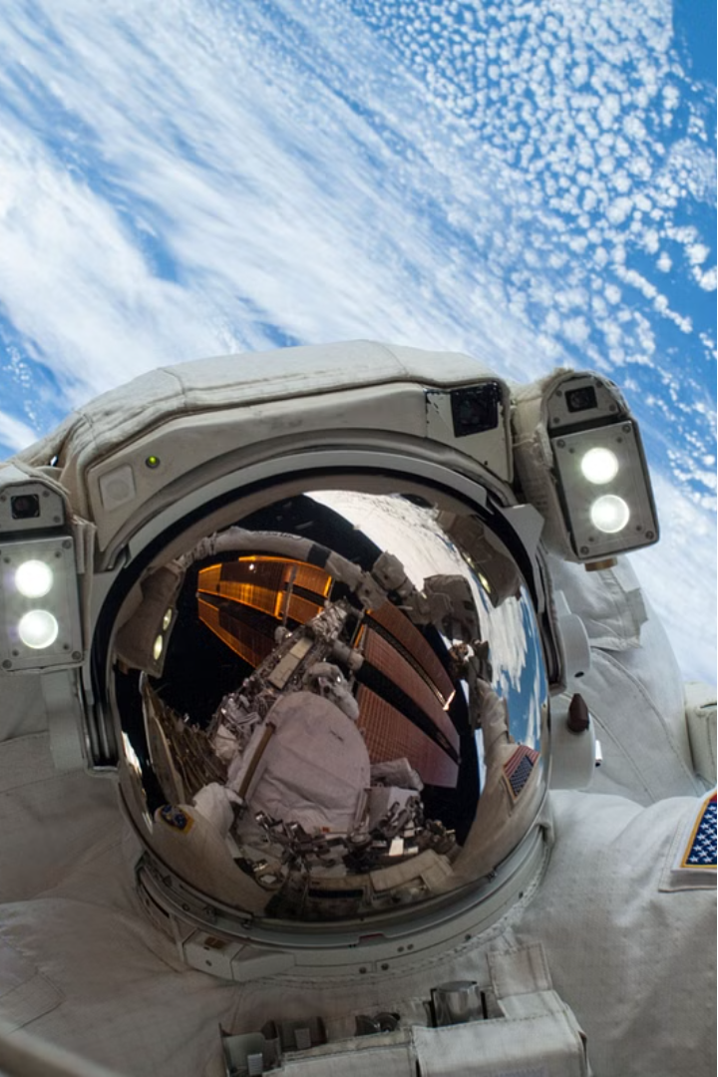
CONCLUSION:-
Our project represents a seamless blend of cutting-edge technology and boundless curiosity for the cosmos. Through the power of React.js, we've crafted an immersive space tourism experience that invites users of all backgrounds to embark on a journey beyond the stars. By prioritizing accessibility and user engagement, we've made space exploration not only informative but also captivating and fun.

Slide 13
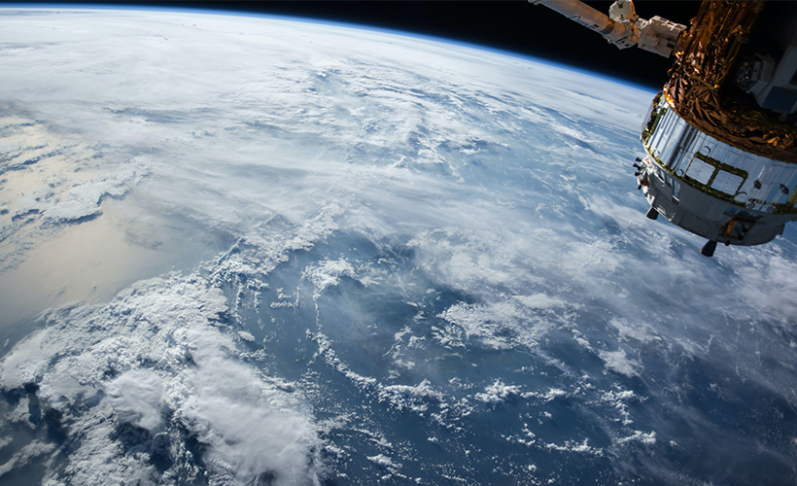
THANK YOU

